Slide 1
After school and Out-of-School Subgrant Program Summer Application Informational Webinar (recorded)
April 2nd, 2024

Slide 2
Introduction
Chloe McElligott – Director of Outreach and Community Engagement
Patrick Stanton – Executive Director

Slide 3
About MAP
MAP is the only statewide non-profit dedicated to professional development and advocacy for all afterschool and summer providers.
MAP serves small, medium, and large providers in both rural and city settings.
MAP builds consensus on afterschool issues to move the field forward in a positive direction.

Slide 4
ASOST-S Grant
After School and Out-of-School Time (ASOST)
Subgrant (S)
Replacing ASOST-Quality Grant
You can still apply if you have received previous ASOST funding for this summer.
Combination of two state grant line items: ASOST (7061-9611) and Summer (7061-9814)
This model was transferred from the Rebound grant (federal COVID-19 dollars).
Previous applications were for both school year and summer. This time, MAP will issue separate summer and school year grant applications.

Slide 5
Eligibility for MAP Summer Grant
You serve school age youth a summer setting.
Your program is geographically located in the cities/towns listed here: Executive Office of Health and Human Service’s Region 1 or Region 5.
School district or 501c(3) non-profit
For profit entities cannot apply.
You are not a YMCA, Boys and Girls Club, or in the City of Springfield.*
*Unless you are a YMCA or B&G Club applying with a school (this is confusing so please confirm with us and your statewide group before applying).

Slide 6
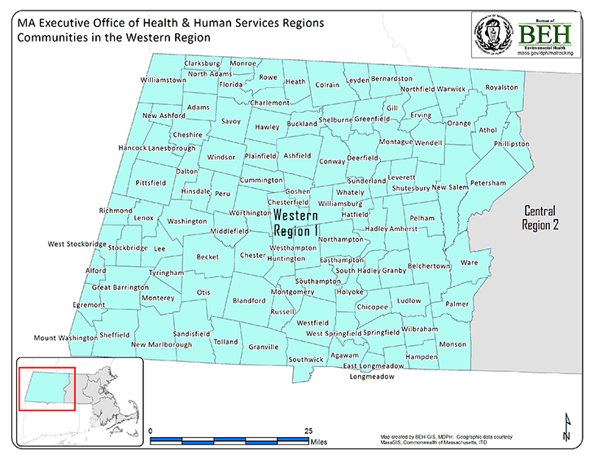
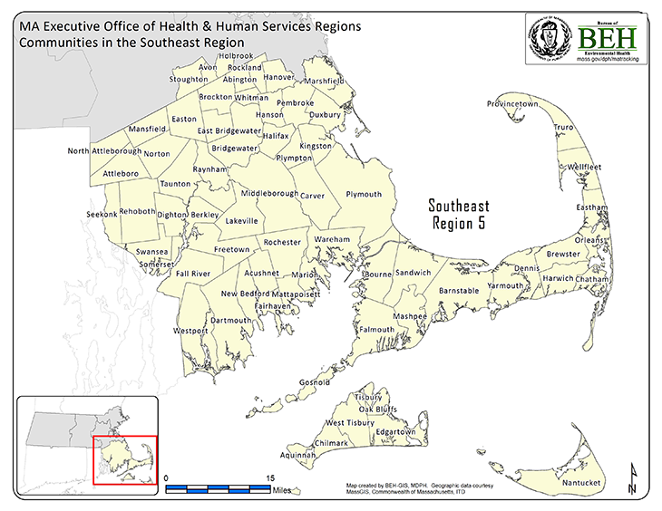
Catchment Areas

Slide 7
Overview of the Summer Grant
$60,000 max per program.
Final funding amounts are set based on number of programs applying, total requested funds, and state funding amounts.
Must serve youth during the summer full time.
Must meet DESE’s criteria for access or quality.
Quality: https://www.doe.mass.edu/grants/2024/528-530/guidelines.docx
Access: https://www.doe.mass.edu/grants/2025/0523-0527-0528/

Slide 8
Funding Examples
Program coordination and programmatic staff costs (including increasing rates/incentives and costs for recruitment efforts as needed to fill staffing gaps)
Scholarships for economically disadvantaged students/families on voucher wait lists or unable to afford programming
Transportation
Materials/supplies for program activities
Food/snacks for participants
Mental/behavioral health services/counselors
Social-emotional learning supports
School/community partner specialist
Family engagement liaison
Enrichment/extracurricular opportunities

Slide 9
What can you NOT spend money on?
Capital improvements
Indirect costs
Equipment costs

Slide 10
Timelines
Application Timeline
Due April 12th
Awards announced May 1st
Grant Timeline
Activities during July 1st, 2024 – August 31st, 2024.
Due to the new GEM$ system, MAP cannot issue funding until July 1st.

Slide 11
Reimbursement of Services Rendered
Previously, MAP was able to request funds prior to dispensing them to grantees.
DESE no longer allows us to do this and we must request reimbursement for services rendered.
MAP will issue payments as quickly as possible but there may be a delay due to the new GEM$ system.

Slide 12
Reporting Requirements
Narrative description of services rendered with funds.
Demographic and program data about students served.
Site visits and expanded review process.

Slide 13
Questions and Answers
Please send questions to Chloe chloe@massafterschool.org
Please put all questions in the chat so we can publish an FAQ on our website.

